Slide 1

Primary memory definition
Primary memory, also known as main memory or RAM, is the computer's temporary storage that holds data and instructions needed by the CPU for quick access. It is fast and volatile, losing its contents when the power is turned off.
Notes:
© Copyright Showeet.com – Free PowerPoint Templates

Slide 2
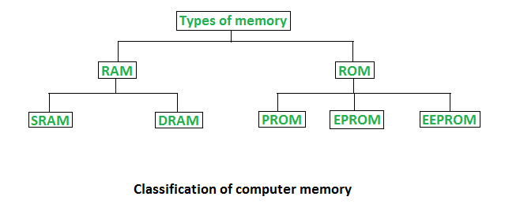
Types of primary memory
Classification of primary memory.
RAM AND ROME
Notes:
© Copyright Showeet.com – Free PowerPoint Templates

Slide 3
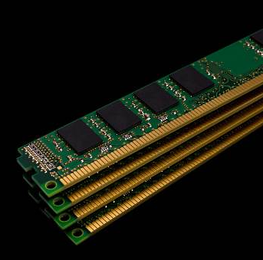
RAM
Temporary Storage: RAM (Random Access Memory) provides fast, temporary storage for data and programs that the CPU needs while a computer is running.
Volatile Memory: RAM is volatile, meaning it loses all stored information when the power is turned off.
Notes:
© Copyright Showeet.com – Free PowerPoint Templates

Slide 4
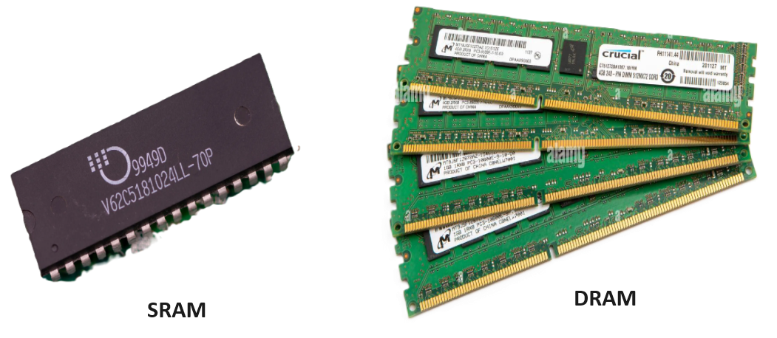
Types of RAM
SRAM
Faster and More Stable: SRAM provides quicker data access and does not require periodic refreshing, making it faster and more stable.
More Expensive and Power-Consuming: SRAM is more costly and consumes more power, making it less practical for large memory capacities compared to DRAM.
DRAM
Cost and Capacity: DRAM is cheaper and offers higher storage density than SRAM, making it ideal for large-capacity memory.
Speed and Refreshing: DRAM is slower than SRAM as it requires constant refreshing to retain data.
FIG:SRAM and DRAM
Notes:
© Copyright Showeet.com – Free PowerPoint Templates

Slide 5
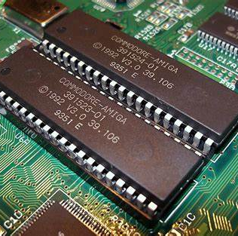
ROM
Non-Volatile: ROM retains data permanently, even when the power is turned off.
Read-Only: It is used to store fixed, unchangeable data like firmware and system boot instructions.
Notes:
© Copyright Showeet.com – Free PowerPoint Templates

Slide 6
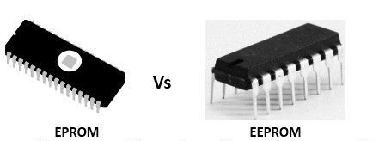
Types of ROM
EEPROM
Erased using ultraviolet (UV) light, which requires removing the chip from the circuit. Erased electrically, allowing for in-circuit modifications without removal.
EPROM
Can be programmed multiple times after erasure, but the process is slower and requires special equipment.
Allows for easier and more frequent reprogramming directly through electrical signals, providing more flexibility.
FIG:EPROM and EEPROM
Notes:
© Copyright Showeet.com – Free PowerPoint Templates

Slide 7
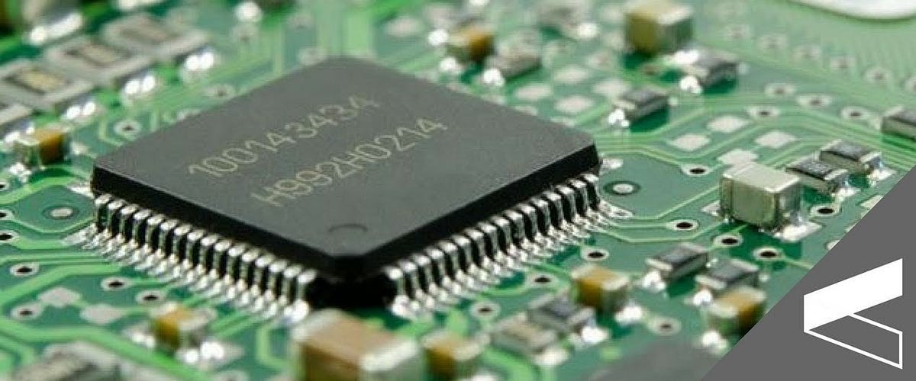
Cache memory
High-Speed Storage: Cache memory provides rapid access to frequently used data and instructions, improving CPU performance.
Temporary Data Storage: It holds copies of data from the main memory to reduce access times and speed up processing.

Slide 8

Large Image slide
SHREE SHANTI BHAGWATI SECONDARY SCHOOL
PRESENTATION BY:
Aashish Subedi
ashisvlog12@gmail.com
PRESENTED TO :
Mukesh Mahato
Mukumukes101@gmai.com
Notes:
© Copyright Showeet.com – Free PowerPoint Templates

